Slide 1
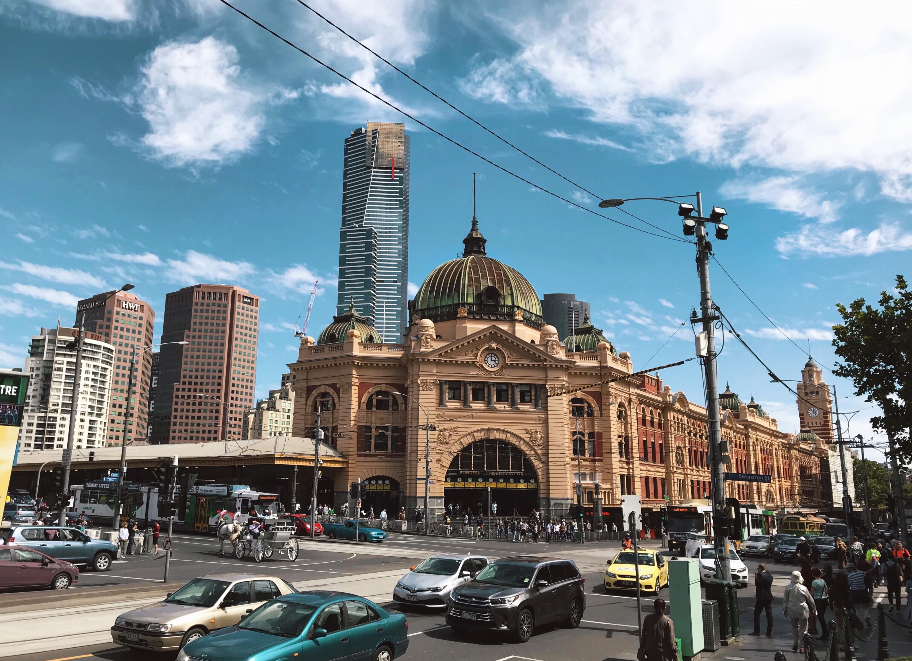
A Growing Concern
The impact of larger vehicles on Victorian roads
Jackie Katsianas
February 2026

Slide 2
Published February 2026 as a data storytelling project as part of the Master of Science in Project Management, Curtin University.
Updated May 2026 with minor refinements to language and attribution, and addition of a methodology section.
This presentation is available online.
For the online version with live links and interactive data charts, please visit https://public.flourish.studio/story/3596389/
Data used for the data visualisations are published as open-access datasets on Zenodo (zenodo.org):
https://doi.org/10.5281/zenodo.18722086
https://doi.org/10.5281/zenodo.18759535
Images, unless stated otherwise, are used under Adobe Standard License.

Slide 3
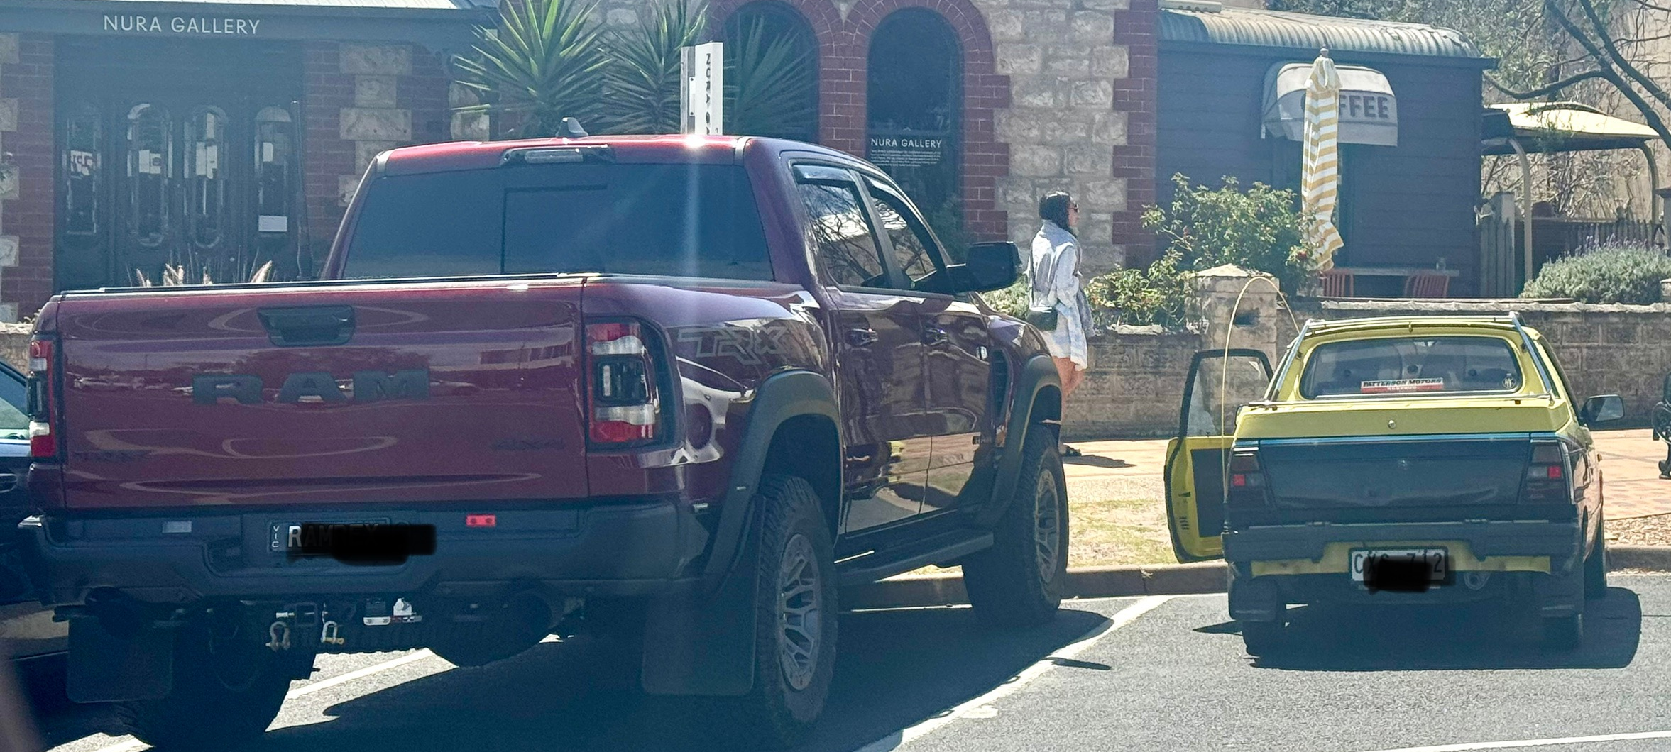
Fleet Transformation
Photo taken January 2025 in Sorrento, Victoria

Slide 4
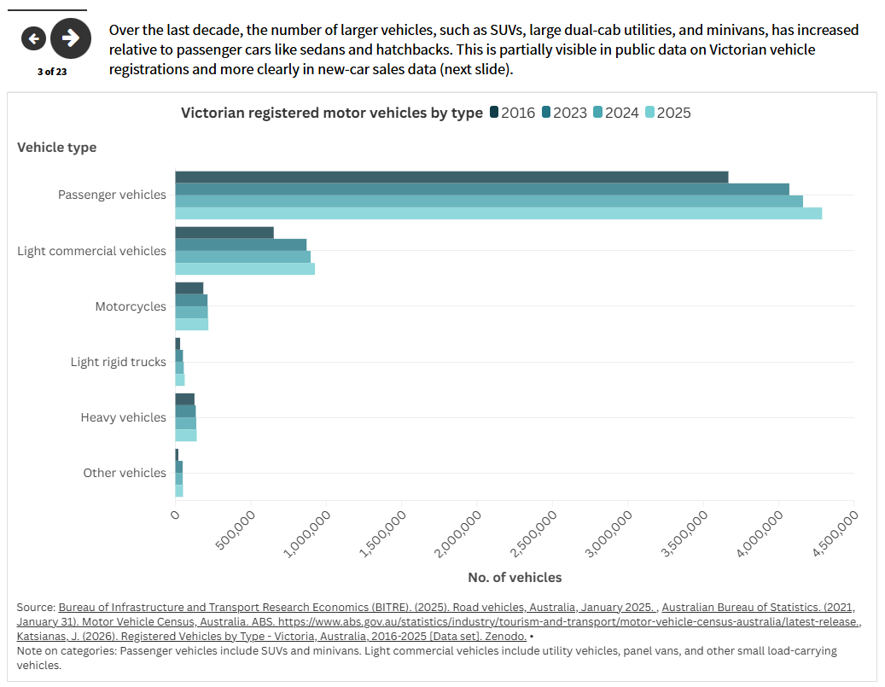
For the online version with live links and interactive data charts, please visit https://public.flourish.studio/story/3596389/

Slide 5
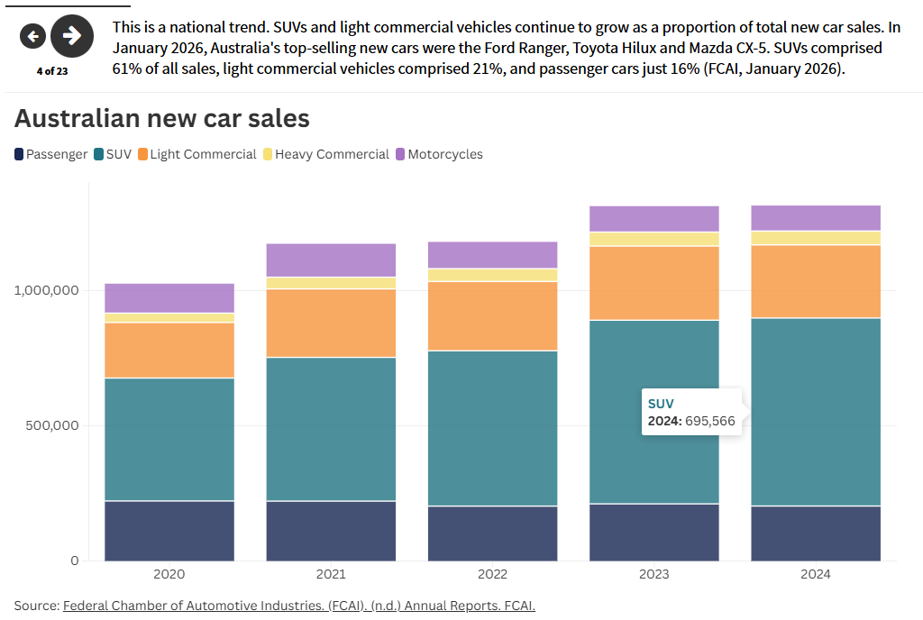
For the online version with live links and interactive data charts, please visit https://public.flourish.studio/story/3596389/

Slide 6
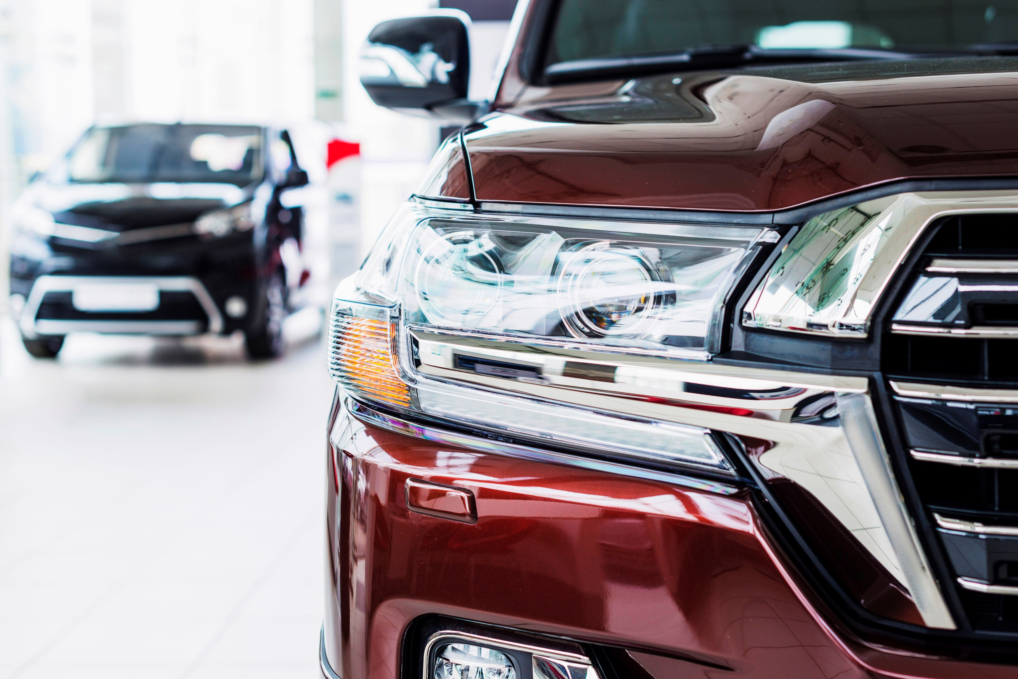
The rise of LLVs
Sports Utility Vehicles (SUVs) are Australia's most popular vehicle (Martin 2023), but another trend on Victoria's roads has been impossible to miss: the rise of larger, higher-bonnet dual-cab utility vehicles such as the recent models of the Ford Ranger, Toyota Hilux, and Dodge Ram.
The growth in these larger utility vehicles has been notable since 2016. It was perhaps in part accelerated by the closure of Ford and Holden manufacturing in Australia, which removed the more traditional, lower-slung "tray utes" from the new-car market (Orana Car and Truck Rentals, n.d.).
SUVs have also grown in size since the mid 2010s.
SUVs and these new larger utilities can be categorised as Large Light Vehicles (LLVs), recognisable for their "high and squarish" shape and larger size compared to traditional passenger cars and utilities (Martin 2023, para. 10).

Slide 7
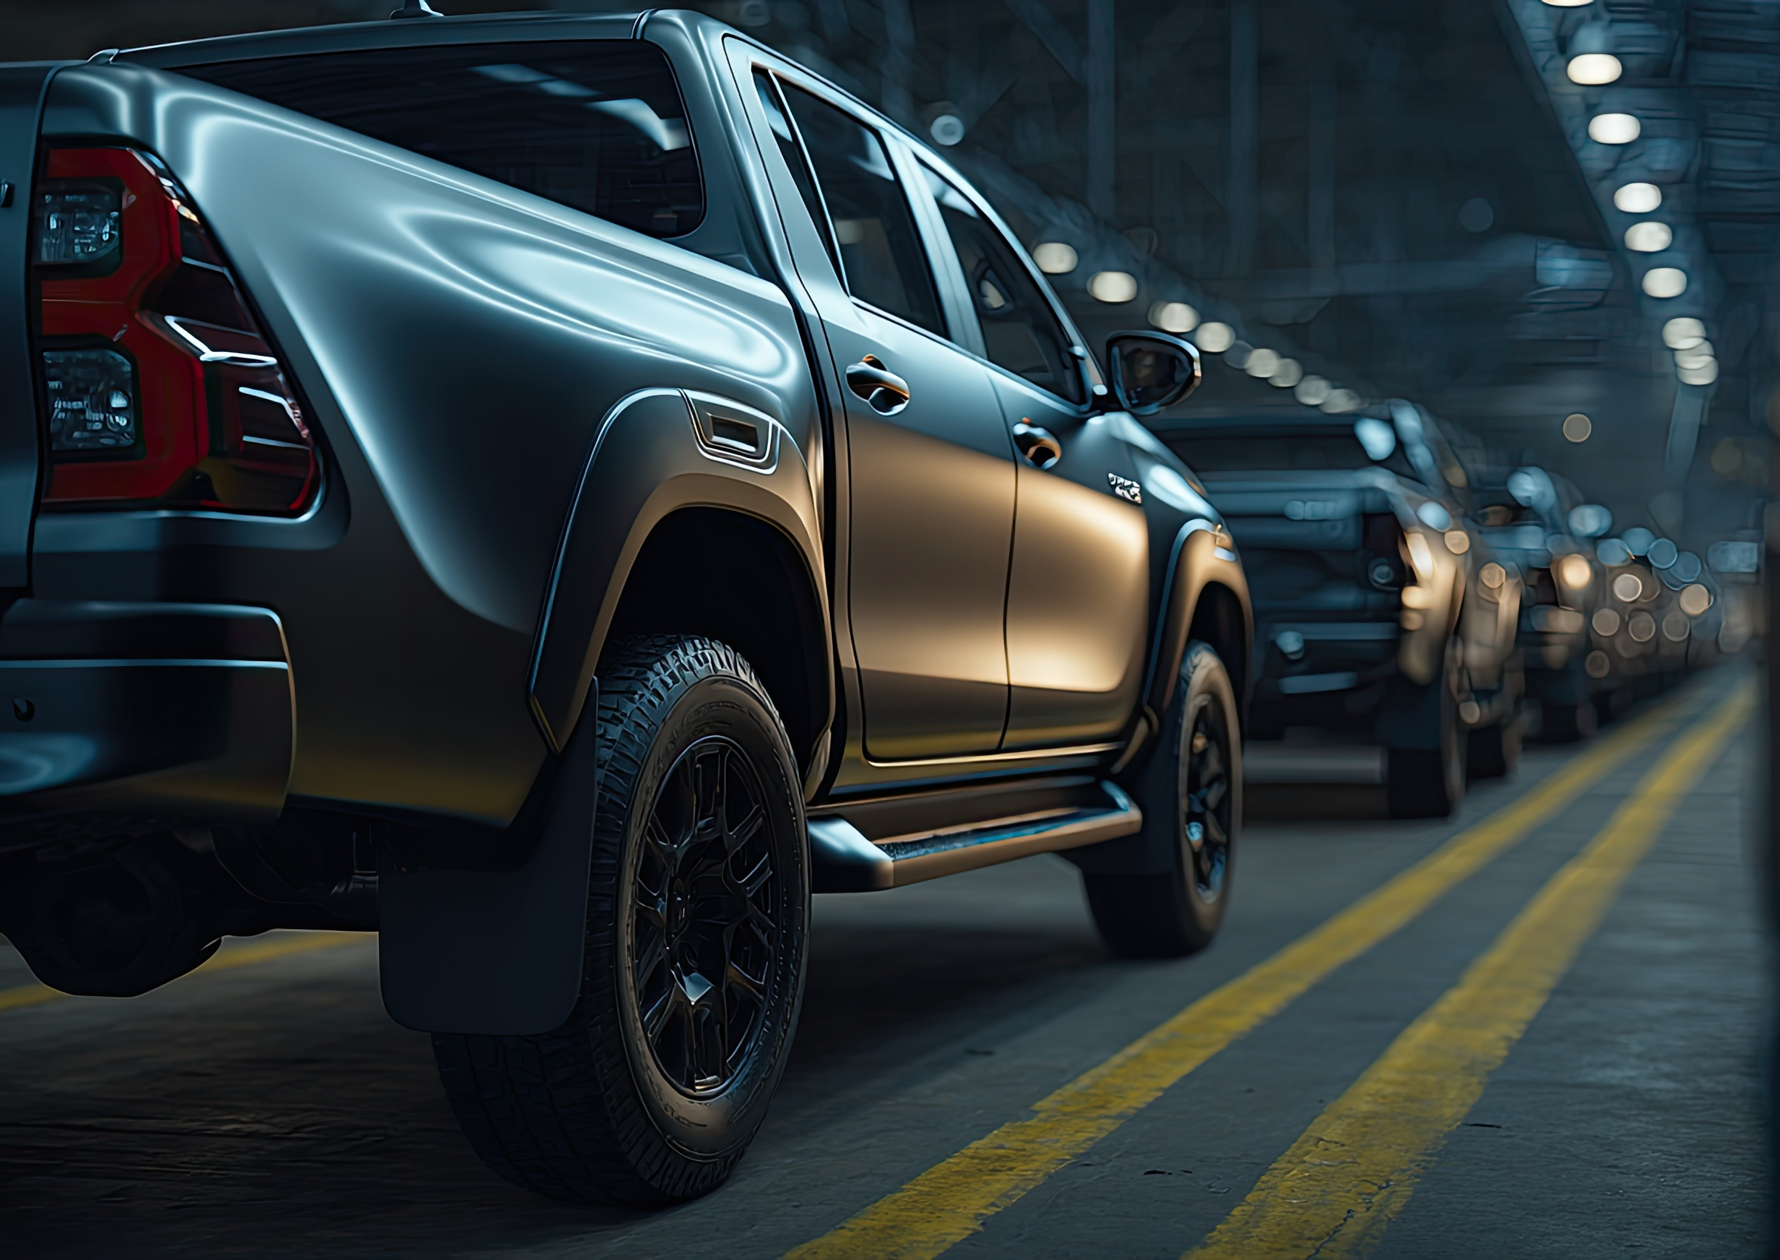
The impact of LLVs
LLVs are having an outsized impact on Australian roads. Outcomes include larger vehicle weights adding to road wear and the reduction in momentum gained in recent years towards reducing vehicle emissions (Martin 2023).
But arguably, the most concerning impact is on the safety of other road users. In particular, research shows that LLVs cause more severe injuries to pedestrians than passenger cars (Robinson et al., 2025).
LLVs give drivers reduced visibility to the back and sides of the vehicle, which is particularly dangerous for child pedestrians and cyclists. (Callaghan 2025).
The following slides present an analysis of Victoria road crash data that supports these findings.

Slide 8
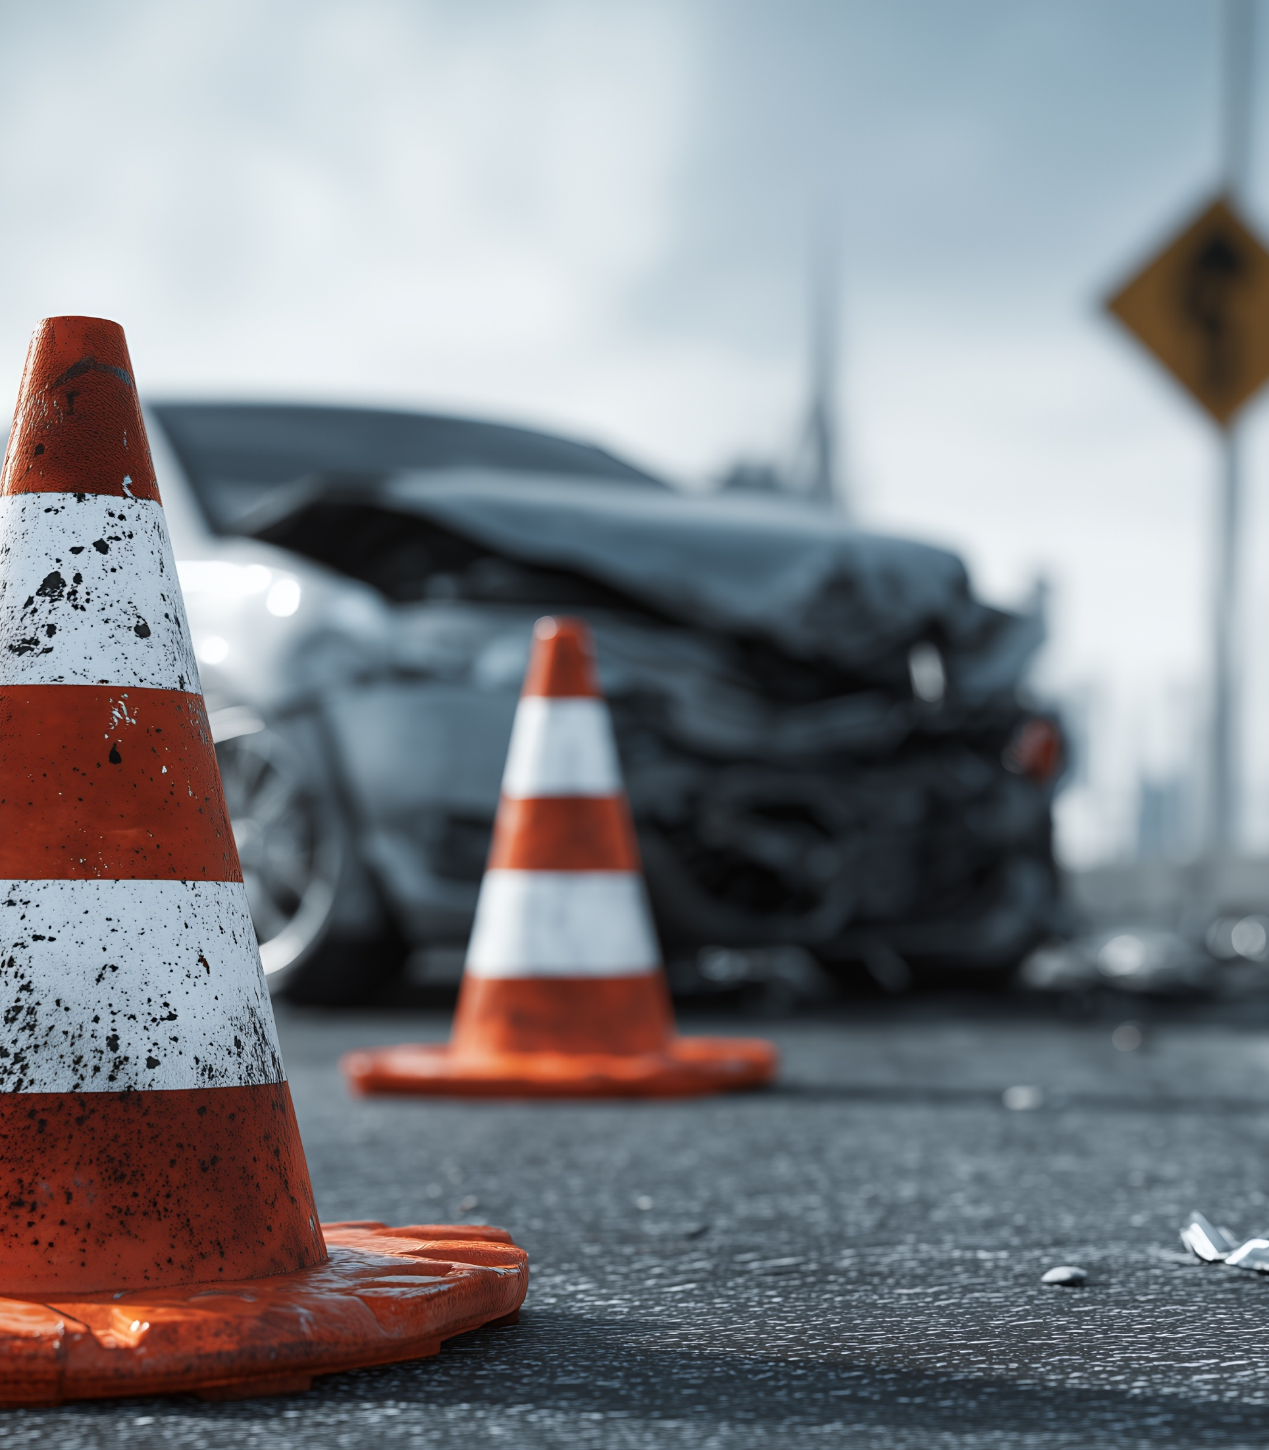
Harm Trends

Slide 9
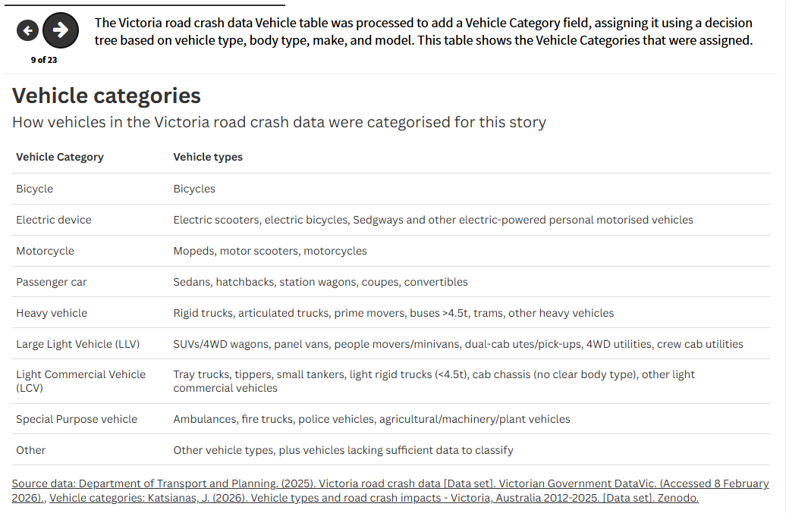
For the online version with live links and interactive data charts, please visit https://public.flourish.studio/story/3596389/

Slide 10
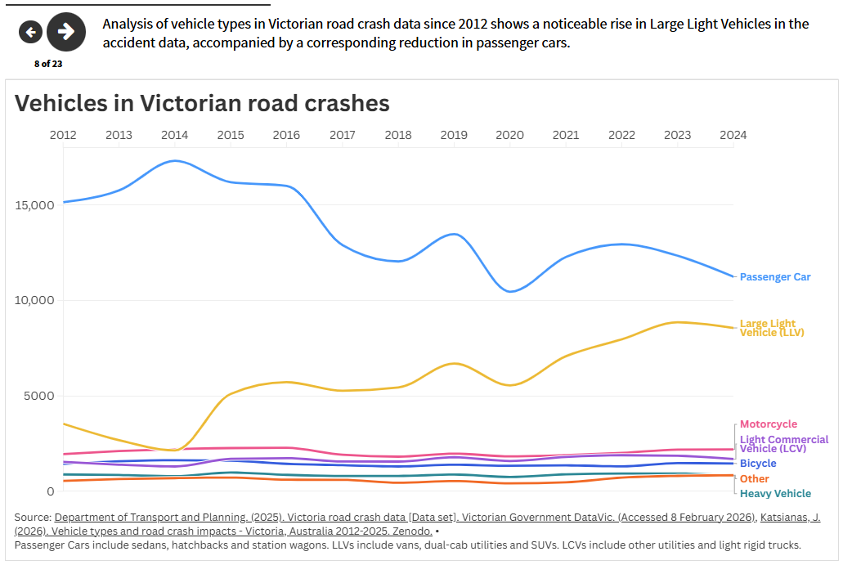
For the online version with live links and interactive data charts, please visit https://public.flourish.studio/story/3596389/

Slide 11
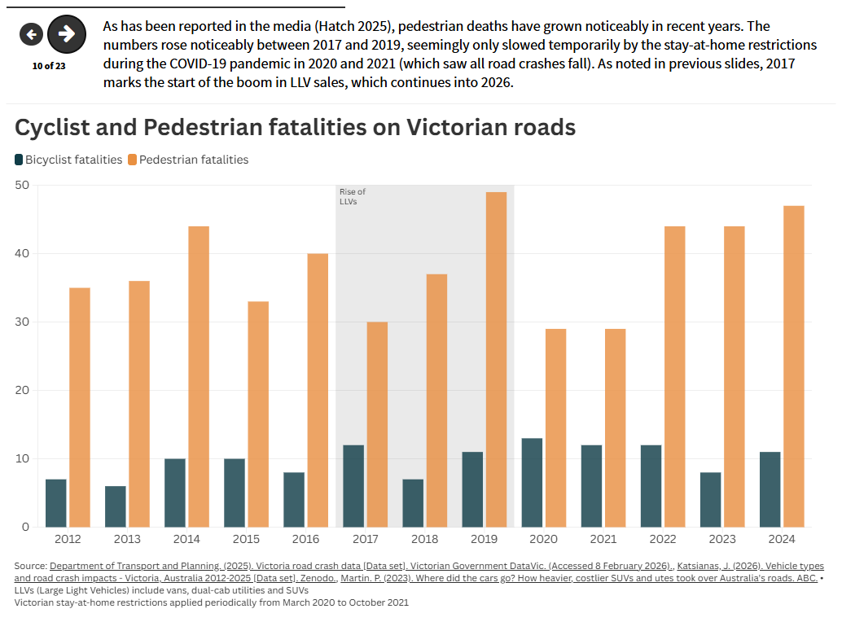
For the online version with live links and interactive data charts, please visit https://public.flourish.studio/story/3596389/

Slide 12
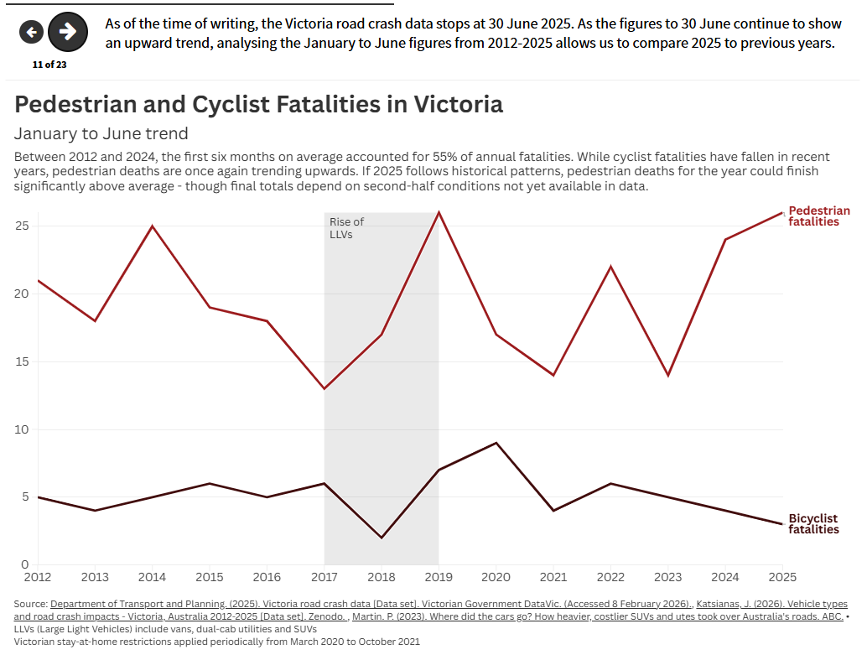
For the online version with live links and interactive data charts, please visit https://public.flourish.studio/story/3596389/

Slide 13
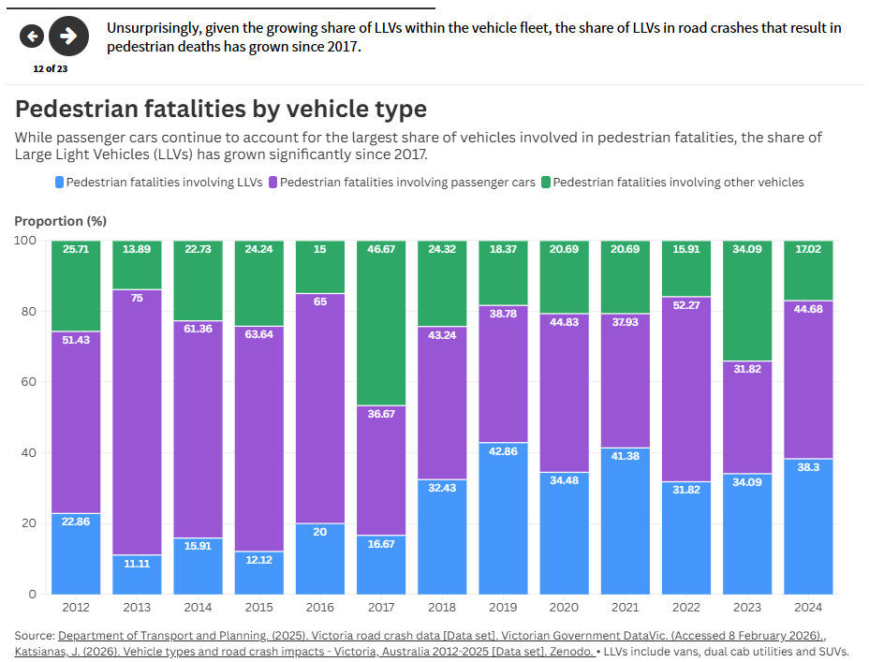
For the online version with live links and interactive data charts, please visit https://public.flourish.studio/story/3596389/

Slide 14
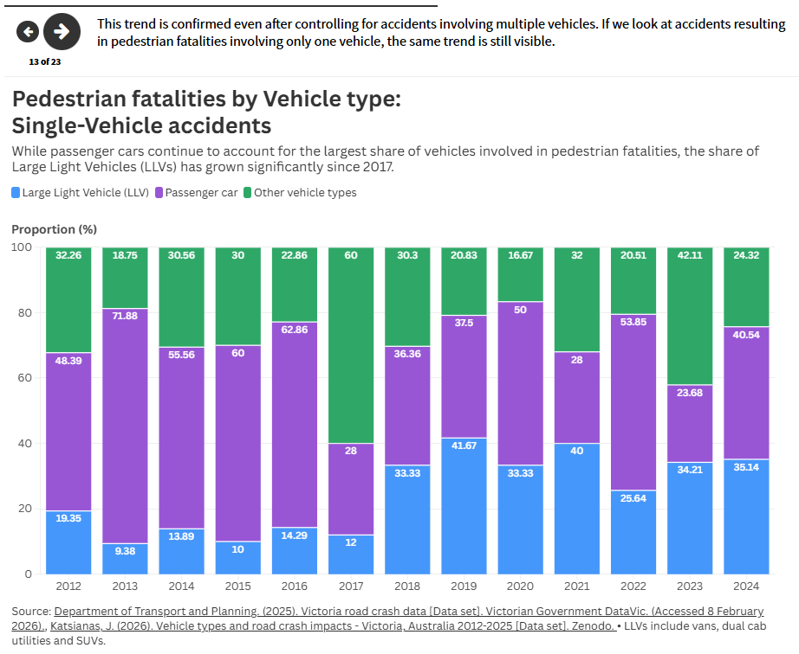
For the online version with live links and interactive data charts, please visit https://public.flourish.studio/story/3596389/

Slide 15
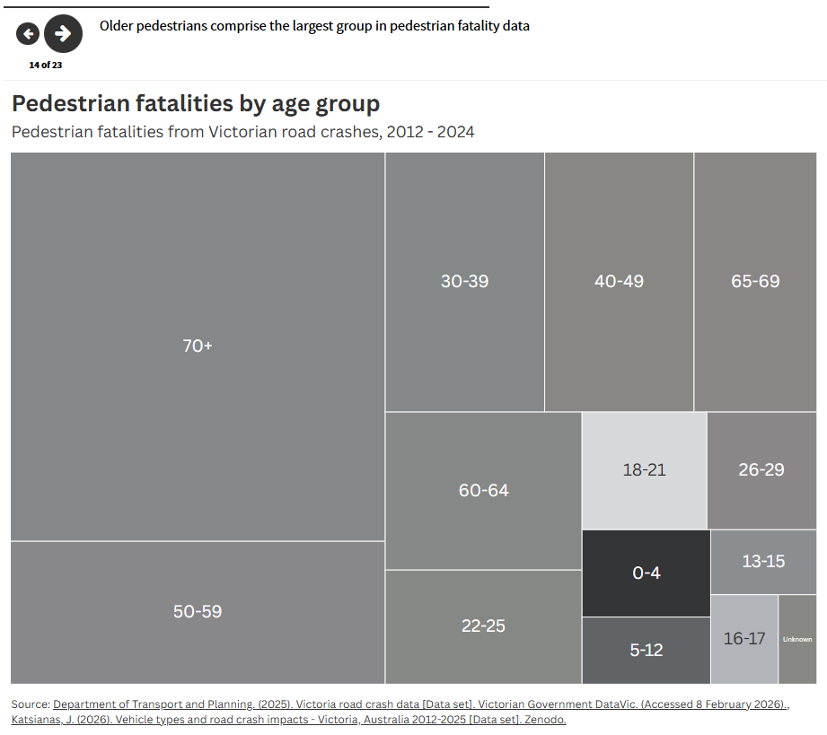
For the online version with live links and interactive data charts, please visit https://public.flourish.studio/story/3596389/

Slide 16
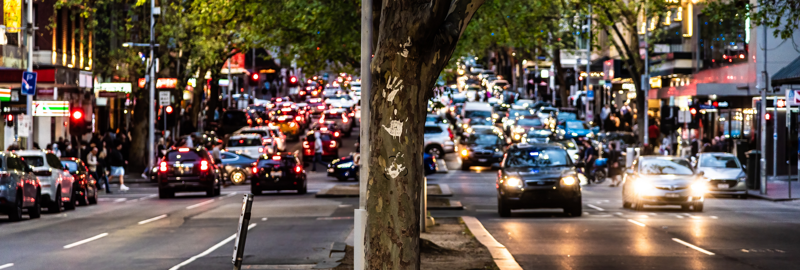
Numbers vs Rates
It could be argued that the rising presence of LLVs in accident data and even in pedestrian deaths is simply due to the increased share of LLVs in the vehicle fleet.
While not a perfect solution, we can account for proportions by using road crash data to calculate a risk rate per vehicle. This is done by dividing the number of crashes that resulted in pedestrian deaths by the total number of crashes involving pedestrians, by vehicle type.

Slide 17
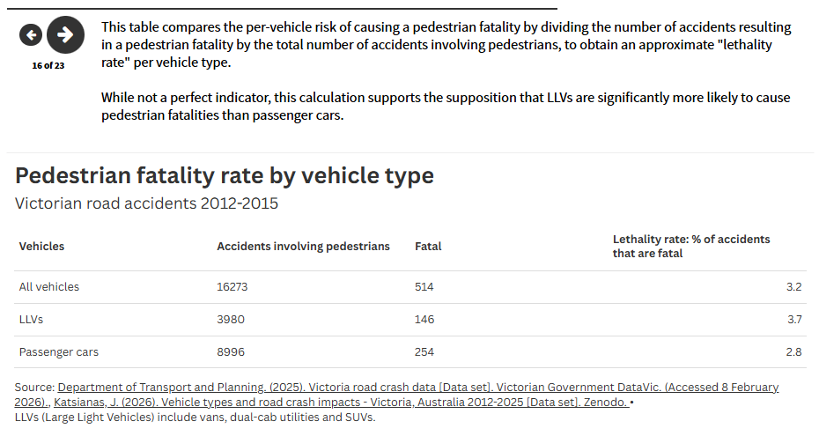
For the online version with live links and interactive data charts, please visit https://public.flourish.studio/story/3596389/

Slide 18
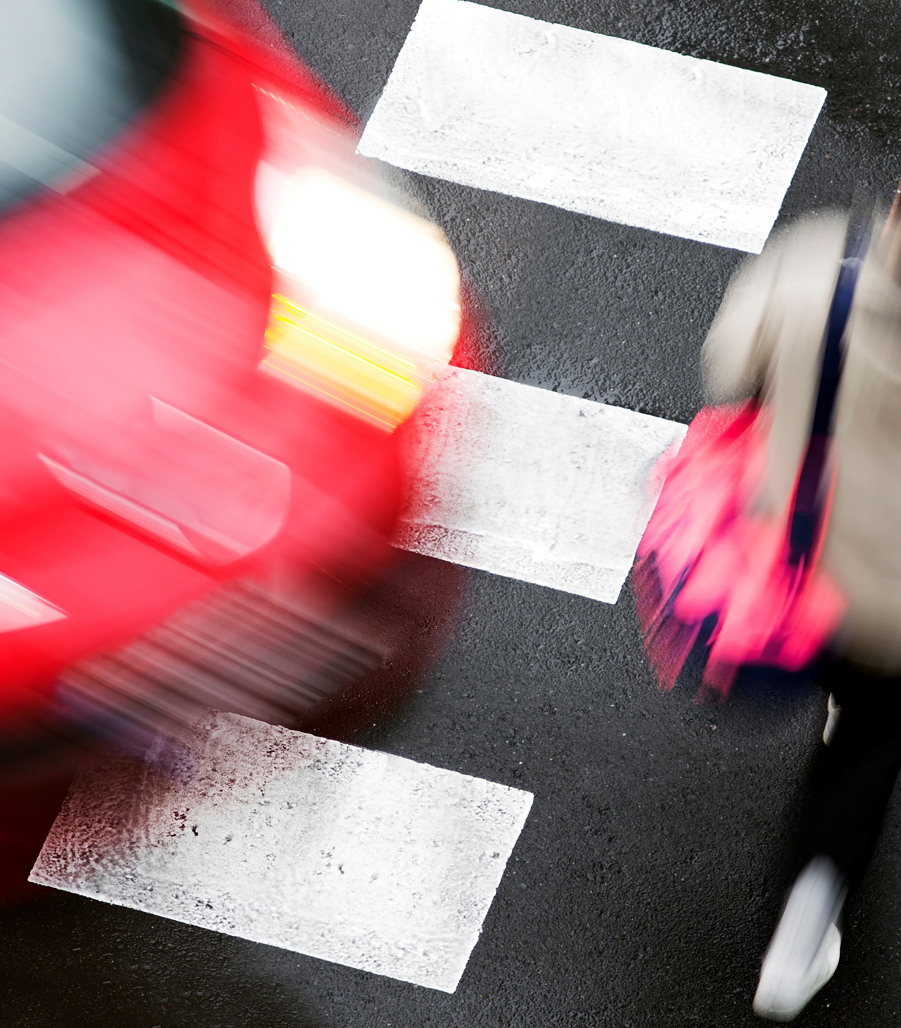
Gaps and confounding factors

Slide 19
Data analysis limitations
The data presented support the general conclusion that the growth in Large Light Vehicles creates a road safety issue for pedestrians.
However, road accidents are complex and frequently involve multiple variables (Oxley et al., 2020). In addition, pedestrians are always the largest and most at-risk road users, "because almost everyone is a pedestrian at some point" (BITRE 2015, p. 2). Multiple factors contribute to road crashes, which cannot be analysed here.
The Victoria road crash data (Department of Transport and Planning, 2025) provides extensive information on road accidents, not all of which could be practicably analysed in this exercise. Speed zones, time of day, weather conditions, road types and locations, vehicle direction and speed at impact, pedestrian age, and other variables were not analysed.
While vehicle types within the road crash data were analysed, it was not possible to measure fatality rates for vehicle types against numbers of registered vehicles, to get a more robust picture of risk rates by vehicle. Publicly available vehicle registration data (ABS; BITRE) does not break down by vehicle type to differentiate LLVs from passenger cars. Industry data (e.g., FCAI, Carsales) categorises vehicles more comprehensively, but is based on new or used car sales rather than registered vehicles, and only limited data is publicly available.

Slide 20
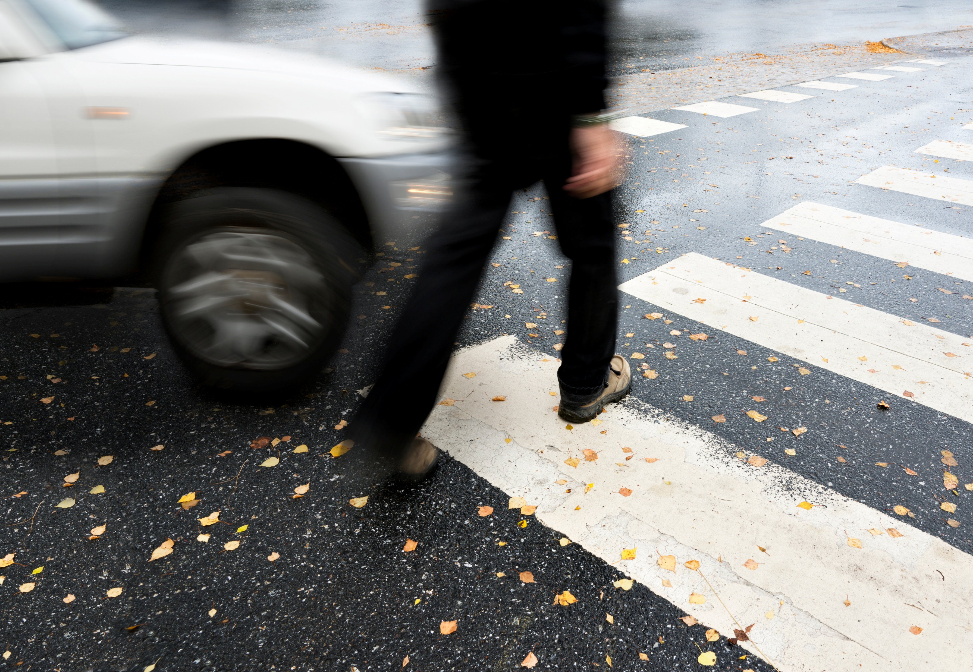
Confounding factors
In addition to the analysis limitations, there are other unknowns and confounding factors that make road safety analysis complex. For example:
New cars have more safety features, including enhanced mirrors and cameras, warnings and better braking systems, which also benefit pedestrians.
Are distractions a factor - screens in cars, pedestrians using phones or headphones?
What has been the impact of the Victorian Government's road safety improvement measures, such as the Level Road Crossing Removal project?

Slide 21
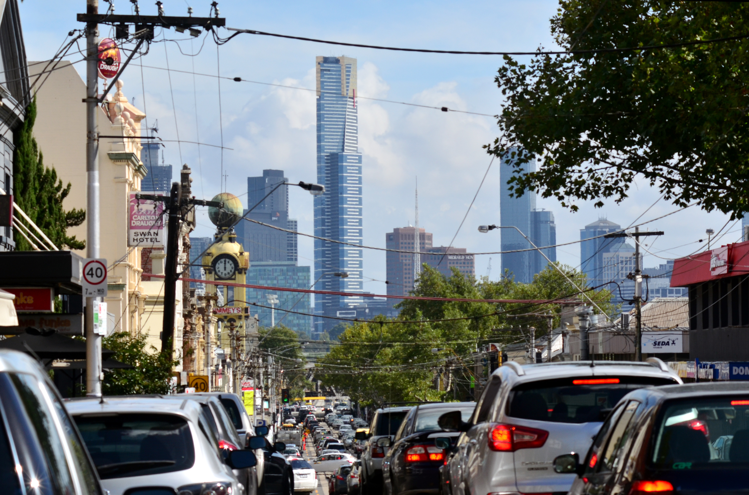
What can be done?
LLVs are here to stay, as they offer drivers benefits such as comfort, safety, space, and design features. It is arguable, though, that incentives are currently skewed, creating negative impacts that could be addressed.
Potential approaches include:
Make larger cars more expensive via higher registration fees
Impose higher parking fees and/or toll road costs on larger cars
Reduce or remove some of the tax incentives for cars that impose a higher cost on society
Add more incentives that encourage the purchase of smaller cars
A TAC public awareness campaign.

Slide 22
References
Australian Bureau of Statistics (ABS). (2021). Motor Vehicle Census, Australia. ABS. https://www.abs.gov.au/statistics/industry/tourism-and-transport/motor-vehicle-census-australia/latest-release
Bureau of Infrastructure and Transport Research Economics (BITRE). (2015). Pedestrians and Road Safety. BITRE. https://www.bitre.gov.au/sites/default/files/is_070.pdf
Bureau of Infrastructure and Transport Research Economics (BITRE). (2024). Road vehicles, Australia, January 2022 (re-issue) [Dataset]. Commonwealth of Australia. https://www.bitre.gov.au/publications/2024/road-vehicles-australia-january-2022-re-issue
Bureau of Infrastructure and Transport Research Economics (BITRE). (2025). Road vehicles, Australia, January 2025. [Dataset]. Commonwealth of Australia. https://www.bitre.gov.au/publications/2025/road-vehicles-australia-january-2025
Callaghan, R. (2025). Why are Aussies ‘supersizing’ their cars? RAC. https://rac.com.au/horizons/drive/australians-buying-larger-cars
Department of Transport and Planning. (2025). Victoria road crash data [Dataset]. Victorian Government DataVic. (Accessed 8 February 2026). https://discover.data.vic.gov.au/dataset/victoria-road-crash-data
Federal Chamber of Automotive Industries. (FCAI). (n.d.) Annual Reports. FCAI. https://www.fcai.com.au/about-fcai/annual-reports/

Slide 23
Federal Chamber of Automotive Industries. (FCAI). (2026). New vehicle sales steady in January 2026. FCAI. https://www.fcai.com.au/australias-new-vehicle-market-remains-resilient-2/
Hatch, P. (2025). "Pedestrian fatalities reach 17-year-high. This trend could be why." The Age. https://www.theage.com.au/national/victoria/pedestrian-fatalities-reach-17-year-high-this-trend-could-be-why-20251227-p5nq8x.html
Katsianas, J. (2026a). Registered Vehicles by Type - Victoria, Australia, 2016-2025 [Dataset]. Zenodo.
https://doi.org/10.5281/zenodo.18722086
Katsianas, J. (2026b). Vehicle types and road crash impacts - Victoria, Australia 2012-2025 [Dataset]. Zenodo. https://doi.org/10.5281/zenodo.18759535
Martin. P. (2023). Where did the cars go? How heavier, costlier SUVs and utes took over Australia's roads. ABC. https://www.abc.net.au/news/2023-10-18/passenger-cars-heavier-costlier-suvs-took-over-australian-roads/102987418
Orana Car and Truck Rentals. (n.d.). The legendary ute: Australia’s iconic workhorse. Retrieved 8 February 2026, from https://www.oranacarandtruck.com.au/blog/the-legendary-ute-australias-iconic-workhorse

Slide 24
Oxley, J., O’Hern, S., Stephan, K., Burtt, D. & Rossiter, B. (2020). Understanding Pedestrian Crashes in Victoria. Victoria Walks. https://www.victoriawalks.org.au/Assets/Files/Understanding-Pedestrian-Crashes.pdf
Pettendy, M. (2017). Why 2017 was the year of the ute. Carsales.
https://www.carsales.com.au/editorial/details/why-2017-was-year-of-the-ute-110363/
Robinson, E., Edwards, P., Laverty, A., and Goodman, A. (2025). "Do sports utility vehicles (SUVs) and light truck vehicles (LTVs) cause more severe injuries to pedestrians and cyclists than passenger cars in the case of a crash? A systematic review and meta-analysis." Injury Prevention, 32(1), 16-24. https://doi.org/10.1136/ip-2024-045613

Slide 25
Photo credits
Cover: Train Station Melbourne Australia Architecture photo by Steph - stock.adobe.com
Slide 3: Fleet Transformation: photo by the author
Slide 6: Car in dealership photo by Freepik – freepik.com
Slide 7: Sleek dark pickup trucks photo by Wandrian – stock.adobe.com
Slide 8: Damaged car on roadside photo by Dzunstock – stock.adobe.com
Slide 16: White handprints on a tree trunk in the middle of Russell Street photo by Adam Calaitzis – stock.adobe.com
Slide 18: Crosswalk photo by GDM photo and video – stock.adobe.com
Slide 20: Dangerous crossing photo by Pink Badger – stock.adobe.com
Slide 21: Heavy traffic in Melbourne photo by Rafael Ben-Ari – stock.adobe.com
All Adobe images are published under Adobe Standard license.

Slide 26
Appendix: Data Methodology
Data Sources
Australian Bureau of Statistics — Vehicle registrations (2016–2021)
Bureau of Infrastructure and Transport Research Economics — Vehicle registrations (2022–2025)
Department of Transport and Planning — Victorian road crash data
Federal Chamber of Automotive Industries — New car sales
Tools: Microsoft Excel (CSV import, processing, pivot tables)
Data Preparation
Analysed metadata to ensure appropriate use
Filtered crash dataset to relevant records:
  Accidents: vehicle collisions & pedestrian strikes
  People: pedestrians, cyclists, e-scooter riders
  Vehicles: retained full vehicle dataset for categorisation
Created documented “processed” datasets and a combined dataset.
For transparency and reproducibility, each processed dataset includes a documented outline of the transformation logic, join keys, and handling of exceptions.
Vehicle Categorisation
Developed a decision-tree approach using:
  Vehicle type → body style → make/model
  Applied categories based on the above
Tested categories using pivot tables for consistency
Excluded unreliable fields (e.g. weight, seating)
Conservative classification applied to minimise misclassification
Data Integration & Analysis
Aggregated data at accident level (to avoid double-counting)
Combined datasets using unique accident identifier
Created derived variables (e.g. specific accident types)
Used pivot tables to summarise:
  Vehicle types involved
  Injury severity (incl. fatalities)
Exported clean tables for visualisation
Key Limitations
Registration and census data lack detail to identify large vehicles
Sales data is not available at state level nor over long timeframes
Growth in large vehicles inferred primarily from crash data
Cannot reliably identify which vehicle caused harm in multi-vehicle crashes
Analysis shows associations, not causation
Analytical Approach
Focus on patterns in accidents involving large vehicles
Emphasis on pedestrian and cyclist harm outcomes
Transparent assumptions and conservative estimates
Datasets are available in Zenodo:
https://doi.org/10.5281/zenodo.18722086
https://doi.org/10.5281/zenodo.18759535

